Slide 1
Natural Language Processing
Week 2

Slide 2
Good evening, everyone. Welcome to the live session.
Today, we will be practicing problems from the current week’s content.
We will wait 5 minutes for everyone to join in and start at 7:05 pm.

Slide 3
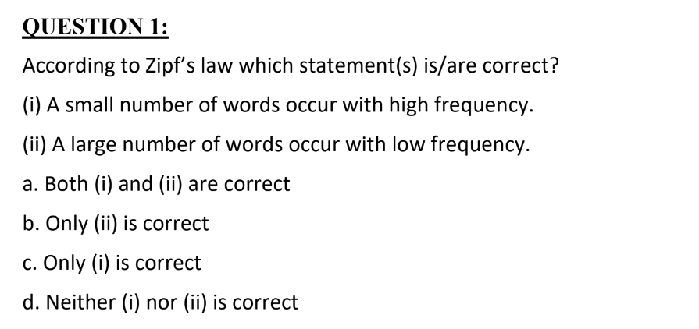

Slide 4

Solution

Slide 5
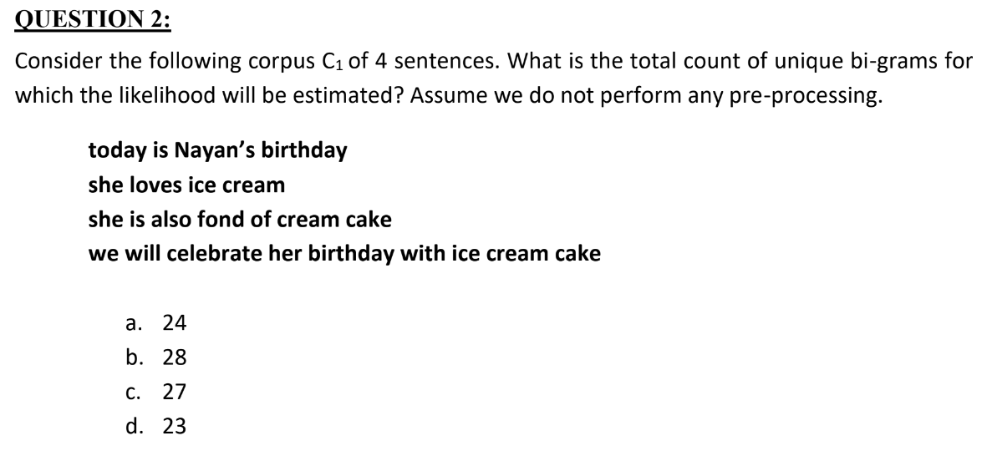

Slide 6
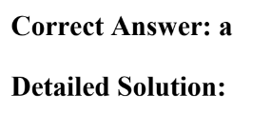

Solution

Slide 7
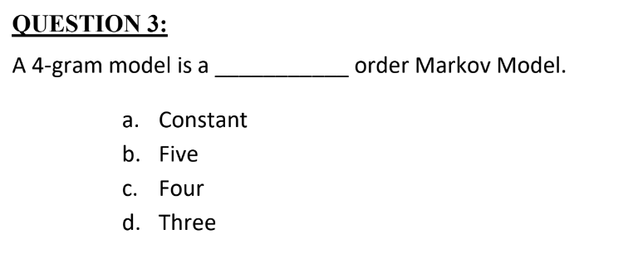

Slide 8



Solution

Slide 9
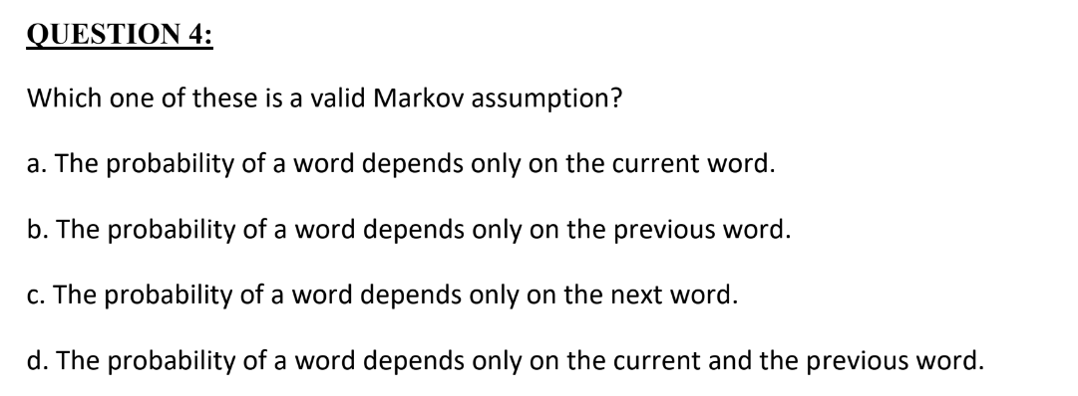

Slide 10

Solution

Slide 11


Slide 12

Solution

Slide 13
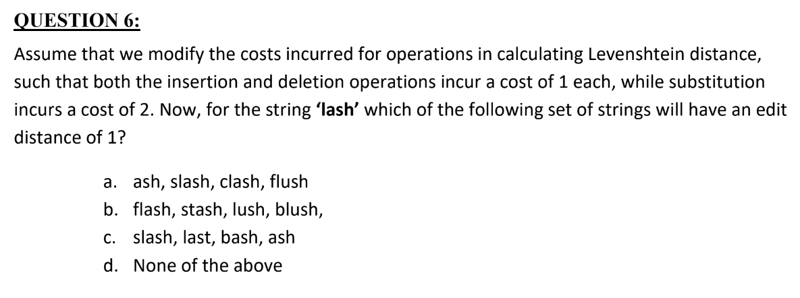

Slide 14

Solution

Slide 15


Slide 16
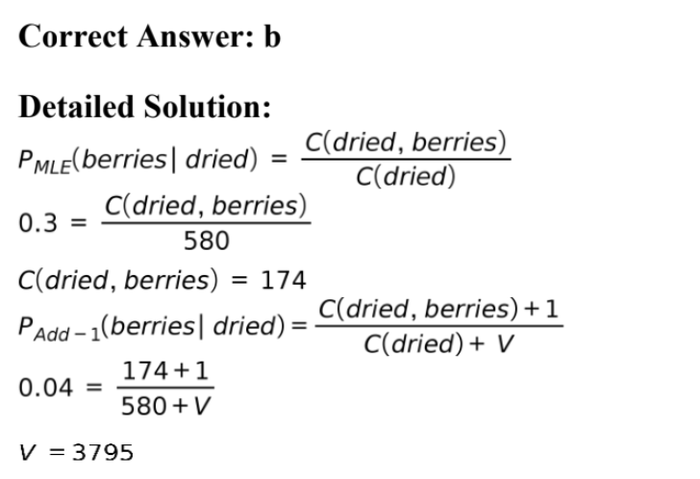
Solution

Slide 17
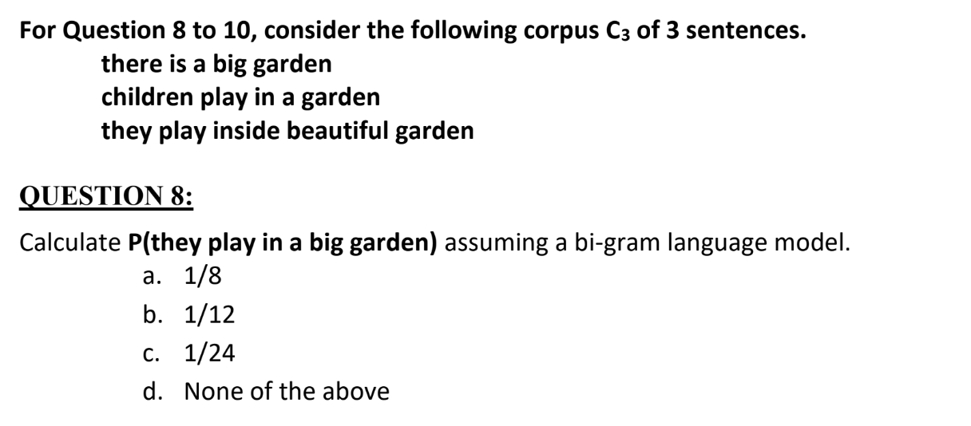

Slide 18
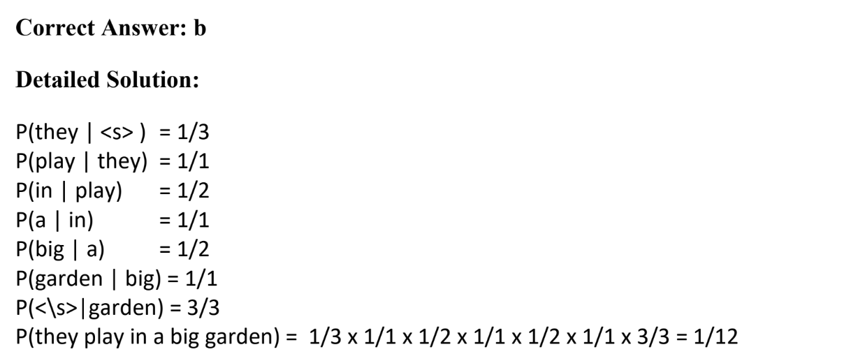
Solution

Slide 19


Slide 20

Solution

Slide 21


Slide 22
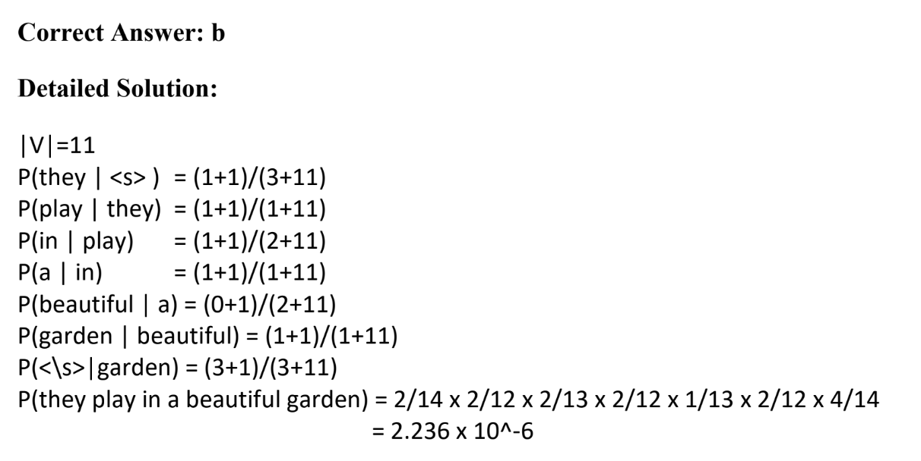
Solution

